Slide 1
Bricklayer Files
By. FAITH mCdONALD

Slide 2
Files For BrickLayer
01_Patterns
02_Pixel Art
03_Saving in Bricklayer-Lite and/or 04_Objects in Bricklayer-Lite
05_Objects Around Bryan in Bricklayer Lite
06_Name_Project
07_Flag_Project
08_More_Patterns
10_Ring_Cirlce_Pattern
11_All_Functions
12_Real_Image
13_Space_Filling_Curves

Slide 3
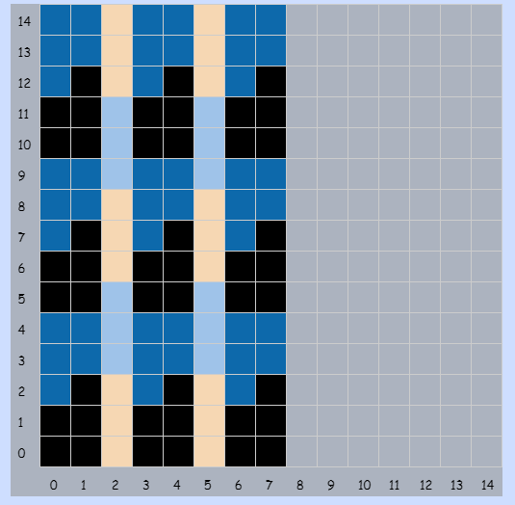
01_Patterns

Slide 4
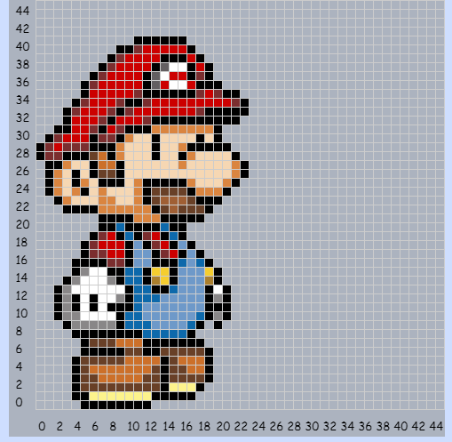
02_PixelArt

Slide 5
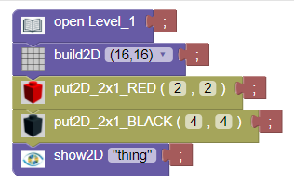
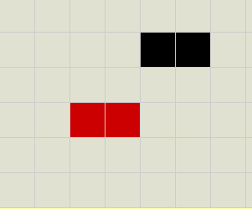
03_Saving in Bricklayer-Lite

Slide 6
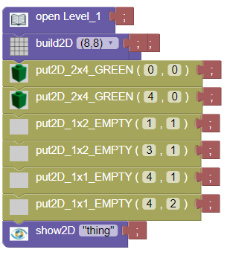
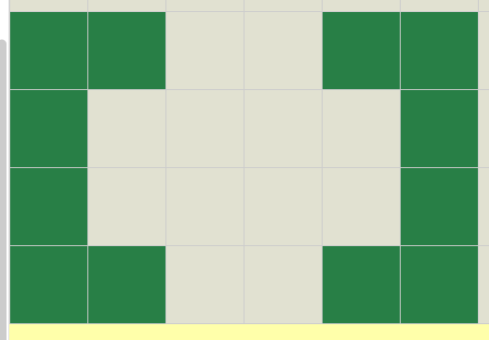
04_Objects in Bricklayer-Lite

Slide 7
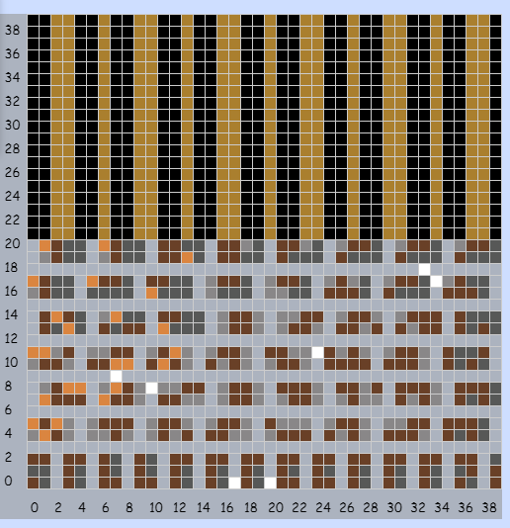
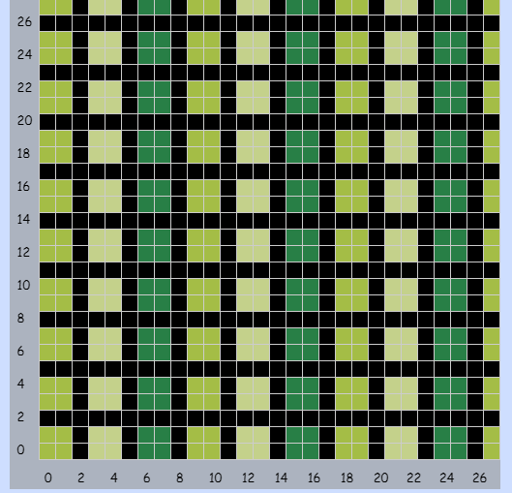
05_Objects Around Bryan

Slide 8
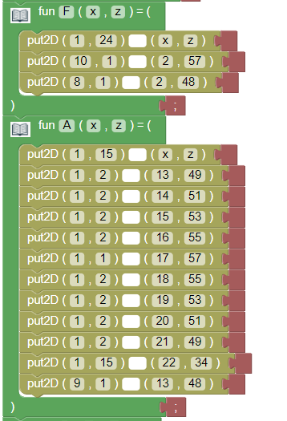
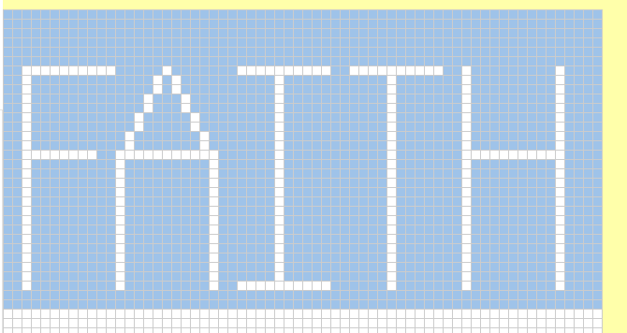
06_Name Project

Slide 9
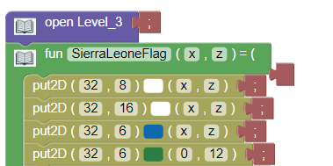
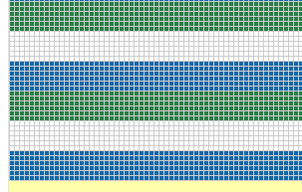
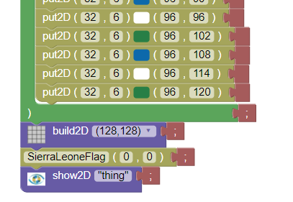
07_Flag_Project

Slide 10
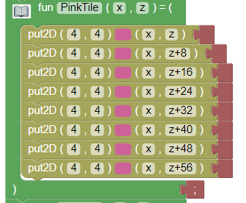
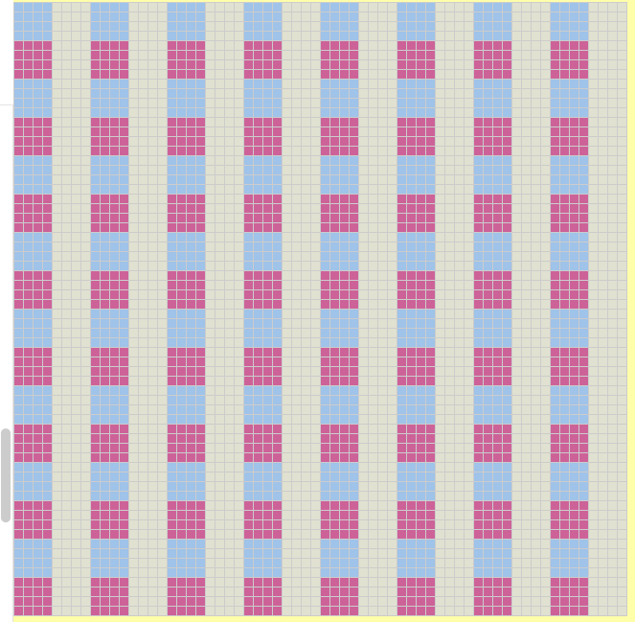
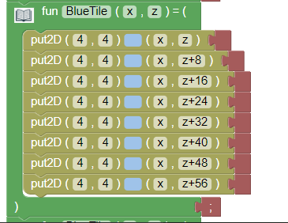
08_More_Patterns

Slide 11
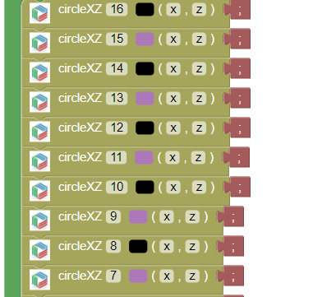
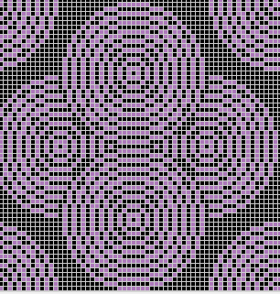
10_Ring_Circle_Patterns

Slide 12
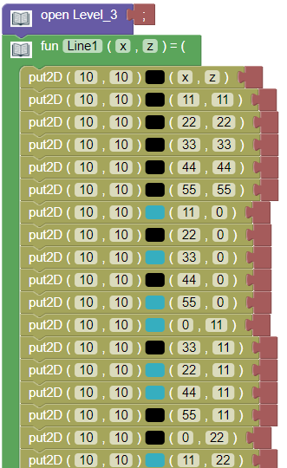
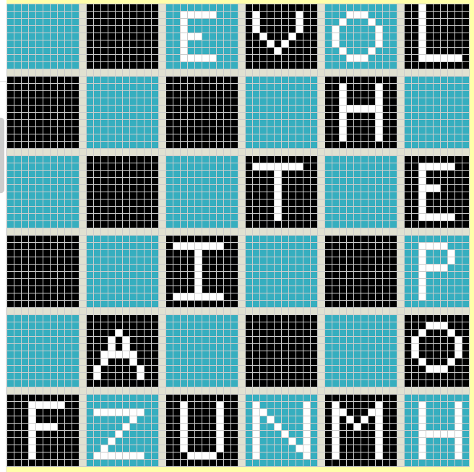
11_All_Functions

Slide 13
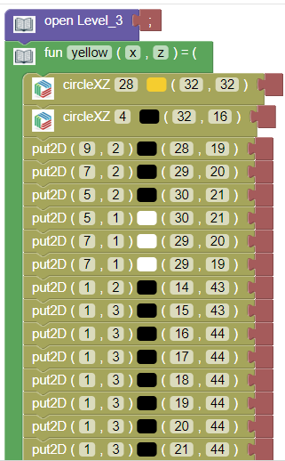

12_Real_Image

